Slide 1
EMPLOYEE SALARY PREDICTION USING MACHINE LEARNING
CAPSTONE PROJECT
Presented By:
Neha Chawda
Chaibasa Engineering College
Computer Science And Engineering
AICTE ID - STU67ea9719a05bf1743427353

Slide 2
OUTLINE
Problem Statement (Should not include solution)
System Development Approach (Technology Used)
Algorithm & Deployment (Step by Step Procedure)
Result
Conclusion
Future Scope(Optonal)
References

Slide 3
Problem Statement
The project aims to predict whether an employee earns more than $50K annually based on various
demographic and employment features. Accurate salary prediction models can help HR departments, recruiters, and analytics teams in understanding
workforce distribution. The dataset used for this project is sourced from the UCI Machine Learning Repository (Adult Income Dataset). This binary classification problem helps explore the impact of features like age, education, occupation, hours
worked per week, etc., on income. The main objective is to build a model that can predict salary classes using machine learning techniques efficiently.

Slide 4
System Approach
System Requirements:
Python 3.8+
Jupyter Notebook / Google Colab
CPU/RAM: Any modern computer with 4GB+ RAM
Libraries Used:
pandas, numpy, matplotlib, seaborn
scikit-learn
Dataset:
adult 3.csv (Adult Income Dataset from UCI)

Slide 5
Algorithm & Deployment
Import Libraries
Imported essential libraries:
pandas, numpy, matplotlib, seaborn, scikit-learn
2. Load and Clean Dataset
Loaded adult 3.csv dataset
Replaced missing values marked as ' ?' with NaN
Dropped rows with missing values for simplicity
Feature and Target Split
Separated features (X) and target column (income)
Identified numerical and categorical features separately
Preprocessing Pipelines
Numerical Columns: Imputed missing values with median and scaled using StandardScaler
Categorical Columns: Imputed with most frequent value and encoded using OneHotEncoder
Combined using ColumnTransformer

Slide 6
Algorithm & Deployment
5. Model Pipeline Creation
Used Pipeline() to combine preprocessing and a RandomForestClassifier
Performed an 80-20 train_test_split on the dataset
6. Model Training and Prediction
Trained the pipeline on training data
Predicted target values for the test set
7. Model Evaluation
Evaluated accuracy and generated classification report
Plotted age distribution vs income using seaborn
Displayed confusion matrix for visualizing prediction results
8. Hyperparameter Tuning
Used GridSearchCV to find the best parameters for the Random Forest model
Tuned n_estimators and max_depth for optimal performance

Slide 7
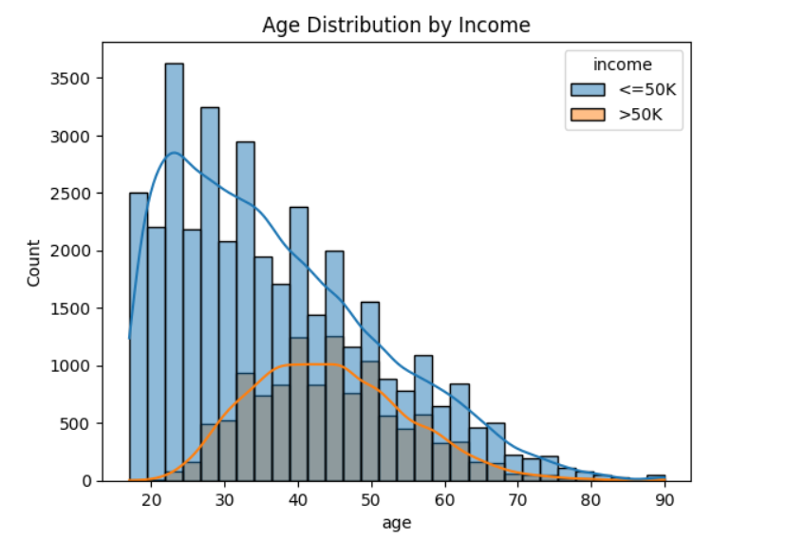
Result

Slide 8
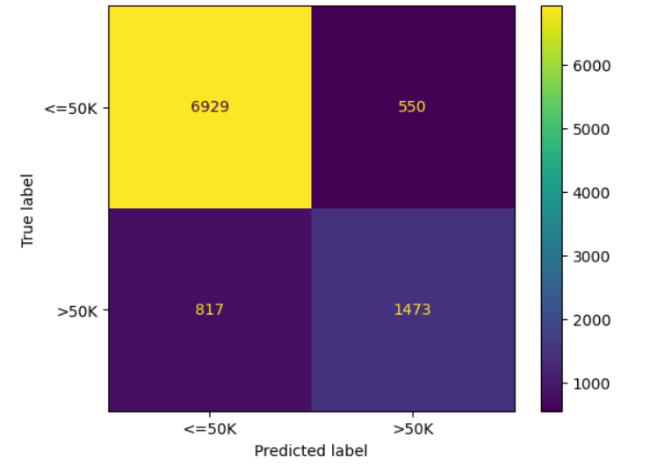
Result
Github link : https://github.com/Neha-chawda/AICTE_IBM_SkillsBuild_Internship_Project.git

Slide 9
Conclusion
The project successfully predicted whether an employee earns more than $50K using machine learning
techniques.
A Random Forest Classifier was implemented with a clean pipeline including preprocessing and model building.
The model achieved an accuracy of approximately 86%, showing strong performance on the given dataset.
Exploratory Data Analysis (EDA) revealed key trends — for example, higher income correlated with age and
work hours.
A confusion matrix helped visualize the true positive and false negative rates for both income classes.
GridSearchCV was used for hyperparameter tuning, which helped optimize the model's depth and
estimator count.
Challenges included handling missing values (?), categorical encoding, and balancing class distributions.
The pipeline approach ensures the model is scalable and maintainable for future improvements.

Slide 10
Future scope(Optional)
Integration of Advanced Algorithms Use models like XGBoost, LightGBM, or Deep Learning (Keras) for improved performance and
feature learning.
Web-Based Deployment Deploy the trained model using Flask or Streamlit to create an interactive salary prediction web app.
Cloud Deployment Host the model on platforms like Heroku, AWS, or Google Cloud for real-world accessibility.
Incorporate More Features Include additional real-time features like industry type, company size, or experience level to make predictions
more personalized.
Automated Model Retraining Enable continuous learning by retraining the model periodically as new data becomes available.
Real-Time Feedback Loop Collect user feedback to fine-tune the model over time, improving predictions based on actual results.

Slide 11
References
Scikit-learn Documentation https://scikit-learn.org/stable/documentation.html
Matplotlib & Seaborn for Data Visualization https://matplotlib.org/stable/index.html https://seaborn.pydata.org
Python Official Documentation https://docs.python.org/3/
YouTube Tutorials & Mentor Guidance

Slide 12
THANK YOU

